Slide 1

PushtiShangar: Streamlining Spiritual Commerce
Presented to Dr. Rutvij Jhaveri Dr. Sonam Nahar Dr. Tanmay Bhowmik
Presented by: Preyash Thakkar (20BCP143)

Slide 2
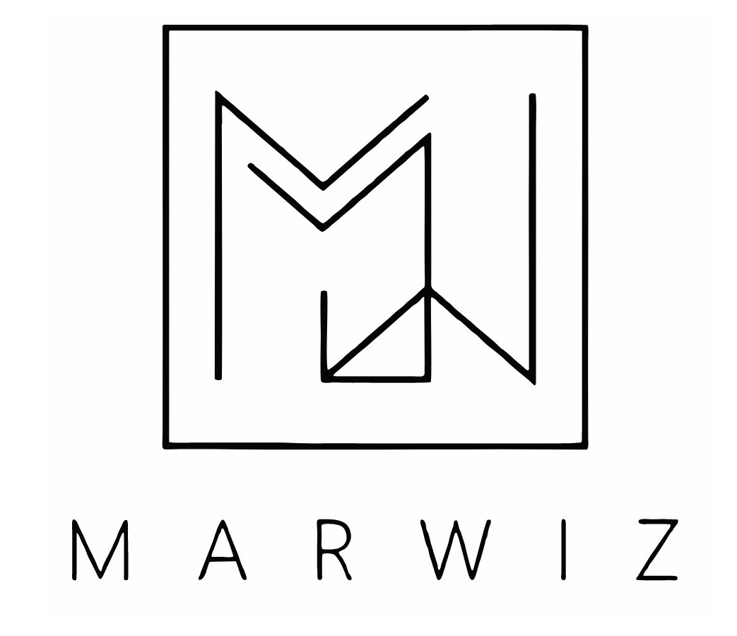
About Company
Marwiz Tech, under unified leadership, pioneers cutting-edge virtual ad management alongside integrated IT solutions. Specializing in streamlined ad campaigns and marketplace innovations, Marwiz Tech delivers comprehensive services, including market research, creative development, and precise analytics. As a singular force, Marwiz embodies tech-driven solutions, empowering businesses with unparalleled insights and seamless ad experiences..

Slide 3

Abstract
1
Vision Statement
Marwiz envisions a tech-driven future where businesses thrive through innovative advertising and streamlined technology solutions.
2
Mission Statement
To simplify and elevate the advertising industry, Marwiz is dedicated to delivering cutting-edge virtual ad management and marketplace solutions that drive client success.
3
Core Values
Innovation, Integrity, Collaboration – Marwiz values drive excellence, ensuring client success through cutting-edge solutions and ethical practices.

Slide 4
Project Introduction
1
Scope
2
Features
3
Benefits
Transforming Pushtishangar's ecommerce, our project introduces an interactive admin panel for seamless product, category, and blog management.
Efficient real-time analytics, simplified task allocation, and reliable risk assessment facilitate straightforward control over the ecommerce platform.
Boost productivity, shorten timelines, and make informed decisions, creating a user-friendly space for Pushtishangar's spiritual offerings.

Slide 5
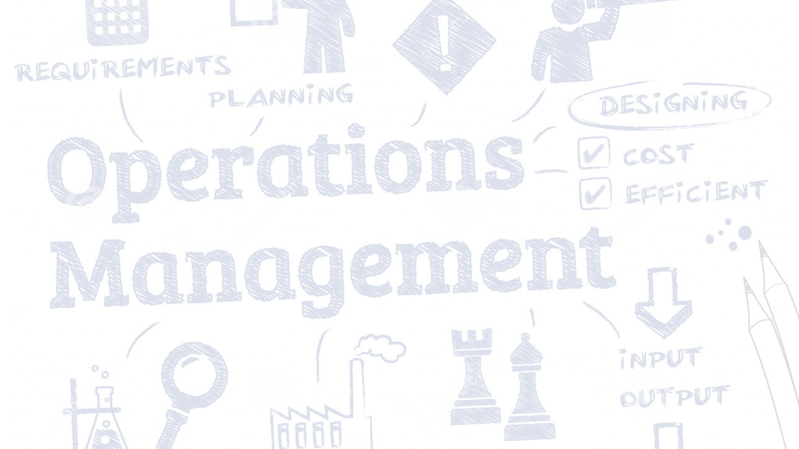
Problem Definition
Inefficient Workflows
Data Overload
Risk Blind Spots
Current systems within Pushtishangar lack the automation needed for the agile demands of our ecommerce project, impacting operational efficiency.
Extracting actionable insights from the substantial volume of project data on the Pushtishangar platform proves challenging, resulting in information overload for our teams.
Identification and mitigation of potential risks are inadequately addressed in the existing Pushtishangar system, creating gaps in risk management.
Technology Solution:
Leveraging the MERN stack, our solution addresses the challenges faced by static websites. By introducing load balancing capabilities, we aim to enhance performance and mitigate the inefficiencies outlined above.

Slide 6




Underlying technology
MongoDB: Leveraging MongoDB for seamless data storage and retrieval, ensuring efficient handling of complex project datasets.
Express: Utilizing Express to build a robust backend, facilitating streamlined processes through smart task allocation and workflow automation.
React: Harnessing the power of React for an interactive user interface, enhancing user experience and decision support.
Node.js: Implementing Node.js to enable advanced server-side operations, providing a foundation for predictive analytics within our project.

Slide 7



Current Status
Design Foundations: Commenced Pushti's journey with wireframes and meticulous database models, setting the stage for a robust project management platform.
Development Progress: Advancing swiftly, we're actively developing core structures and functionalities. Regular client feedback sessions ensure alignment with expectations and enhance usability.
Dynamic Adaptation: Though some functionalities are presently hard-coded, our focus remains on transforming them into dynamic components, ensuring ongoing adaptability in refining the evolving Pushti project management platform.

Slide 8
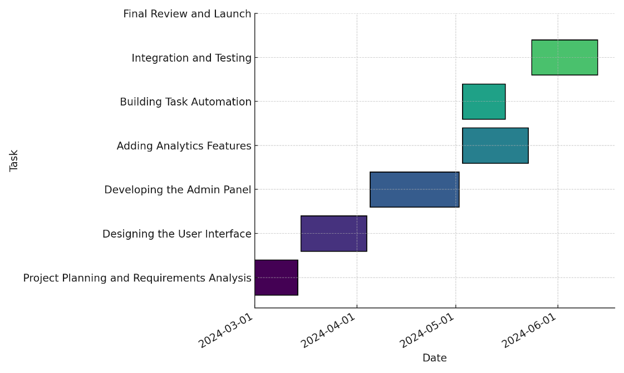
Gantt chart
A timeline visualization of key tasks for Pushtishangar's ecommerce website development project.

Slide 9
Conclusion: As we conclude the Pushtishangar project, we anticipate widespread adoption and potential partnerships for our advanced project management platform.
Future Prospects
Impact
Next Steps
Looking ahead, our focus is on establishing solid foundations for the Pushtishangar project, fostering collaborations and envisioning expanded horizons.
We envision a significant transformation in project management efficiency, ushering in an era of informed decision-making and operational excellence.
Moving forward, our journey involves further development, thorough testing, and strategic preparations for a successful market entry for Pushtishangar.

